Slide 1


UNIVERSITY INSTITUTE OF ENGINEERING
COMPUTER SCIENCE & ENGINEERING
Introduction to Information Security and Cryptography
(Subject Code:20CST-354/ITT-354)
Prepared By : Er. Puneet kaur(E6913)
INTRODUCTION
DISCOVER . LEARN . EMPOWER

Slide 2

HMAC Algorithm
www. cuchd.in Campus : Gharaun, Mohali

Slide 3
HMAC Algorithm
HMAC algorithm stands for Hashed or Hash based Message Authentication Code. It is a result of work done on developing a MAC derived from cryptographic hash functions.
HMAC is a great resistant towards cryptanalysis attacks as it uses the Hashing concept twice.

Slide 4
HMAC Algorithm
HMAC consists of twin benefits of Hashing and MAC, and thus is more secure than any other authentication codes. RFC 2104 has issued HMAC, and HMAC has been made compulsory to implement in IP security. The FIPS 198 NIST standard has also issued HMAC.

Slide 5
HMAC Algorithm: Objectives
As the Hash Function, HMAC is also aimed to be one way, i.e, easy to generate output from input but complex the other way round.
It aims at being less effected by collisions than the hash functions.
HMAC reuses the algorithms like MD5 and SHA-1 and checks to replace the embedded hash functions with more secure hash functions, in case found.
HMAC tries to handle the Keys in more simple manner.

Slide 6
HMAC Algorithm
The working of HMAC starts with taking a message M containing blocks of length b bits. An input signature is padded to the left of the message and the whole is given as input to a hash function which gives us a temporary message digest MD’. MD’ again is appended to an output signature and the whole is applied a hash function again, the result is our final message digest MD.
Here is a simple structure of HMAC:

Slide 7
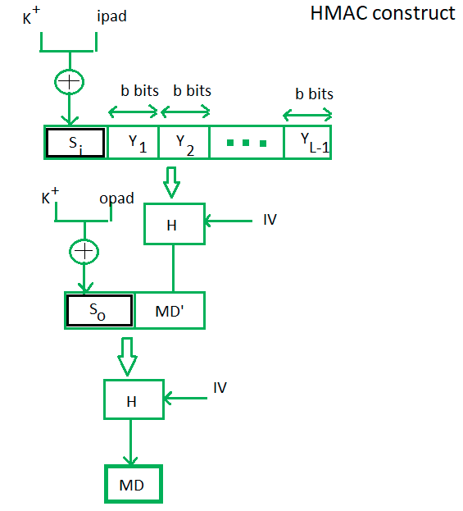
HMAC Algorithm

Slide 8
HMAC Algorithm
Here, H stands for Hashing function, M is original message Si and So are input and output signatures respectively, Yi is the ith block in original message M, where i ranges from [1, L) L = the count of blocks in M K is the secret key used for hashing IV is an initial vector (some constant) The generation of input signature and output signature Si and So respectively.

Slide 9
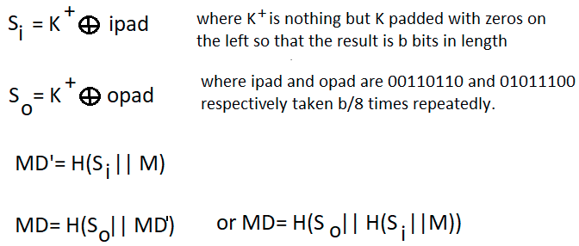
HMAC Algorithm
To a normal hash function HMAC adds a compression instance to the processing. This structural implementation holds efficiency for shorter MAC values.

Slide 10
CMAC (Cipher-based Message Authentication Code)
CMAC (Cipher-based Message Authentication Code) is a block
cipher based MAC algorithm. It may be used to provide assurance of
the authenticity and, hence, the integrity of binary data. This mode
of operation fixes security deficiencies of CBC-MAC .

Slide 11
CMAC (Cipher-based Message Authentication Code)
I N F O R M A T I O N A N D N E T W O R K S E C U R I T Y 7
C1 = E(K, M1)
C2 = E(K, [M2 ⊕ C1])
C3 = E(K, [M3 ⊕ C2])
:
Cn = E(K, [Mn ⊕ Cn-1 ⊕ K1])
T = MSBTlen(Cn)
Where,
T = message authentication code,
also referred to as the tag
Tlen = bit length of T
MSBs(X) = the s leftmost bits of the
bit string X

Slide 12
CMAC (Cipher-based Message Authentication Code)

Slide 13
CMAC (Cipher-based Message Authentication Code)
§ Advantages
•Can use existing encryption functions.
•Encryption functions have properties that resist pre image and collision
attacks
§ Disadvantage
•Encryption algorithms (particularly when chained) can be much slower than
hash algorithms

Slide 14
References
http://www.brainkart.com/article/Classical-Encryption-Techniques_8339/
https://www.tutorialspoint.com/cryptography/index.htm
https://www.geeksforgeeks.org/cryptography-introduction/
https://www.techopedia.com/definition/1770/cryptography#:~:text=Cryptography%20involves%20creating%20written%20or,information%20to%20be%20kept%20secret.&text=Information%20security%20uses%20cryptography%20on,transit%20and%20while%20being%20stored.
https://www2.slideshare.net/lineking/classical-encryption-techniques-in-network-security?qid=e388c29f-793d-4f2b-bcaf-9d22e9ca07b5&v=&b=&from_search=1

Slide 15
E- Books Recommended
https://www.pdfdrive.com/cyber-security-books.html
https://bookauthority.org/books/new-cyber-security-ebooks
https://bookauthority.org/books/best-cyber-security-ebooks
https://www.freetechbooks.com/information-security-f52.html

